Slide 1
INVESTMENT OPPORTUNITY | REPUBLIC OF MOLDOVA
BUCOVĂȚ MULTIMODAL
INDUSTRIAL & LOGISTICS HUB
Existing 10.5 ha brownfield platform: rail-road terminal for construction materials + rapeseed processing (crude oil and meal)
Bucovăț, Strășeni district, Republic of Moldova
~€2.45 mil.
10.5 ha
~€1.4–1.6 mil./yr
Brownfield
Total CAPEX
platform
combined result at capacity
investment type

Slide 2
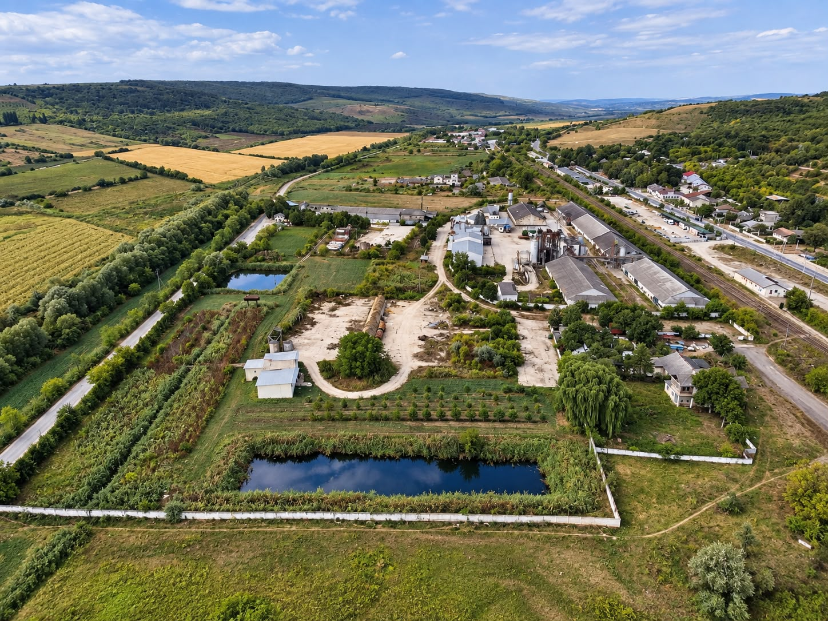
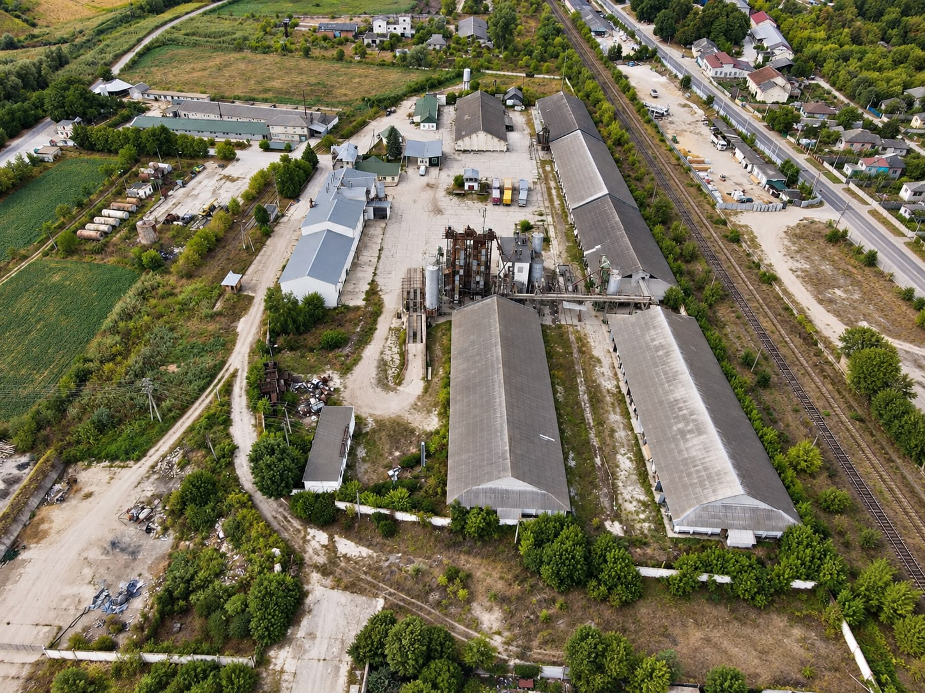
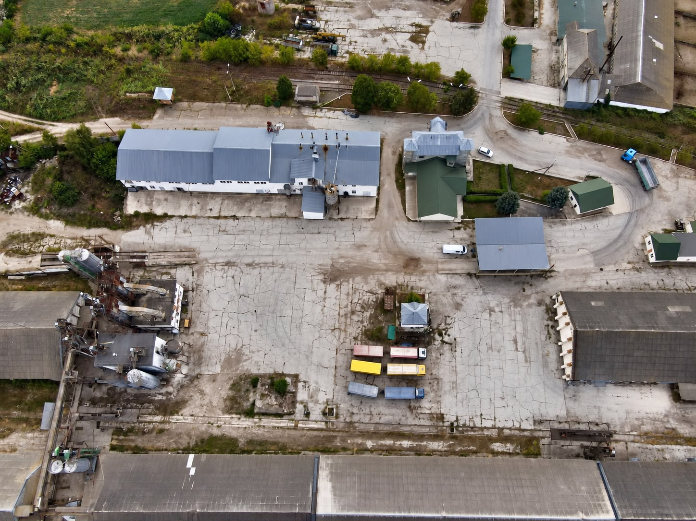
The Site in Pictures (1/2)
General view of the platform — ponds, buildings and internal railway
Existing industrial warehouses, adjacent to the rail line
Concrete platform and technology area — existing installations
Bucovăț Multimodal Industrial & Logistics Hub | Preliminary Investment Profile
2

Slide 3
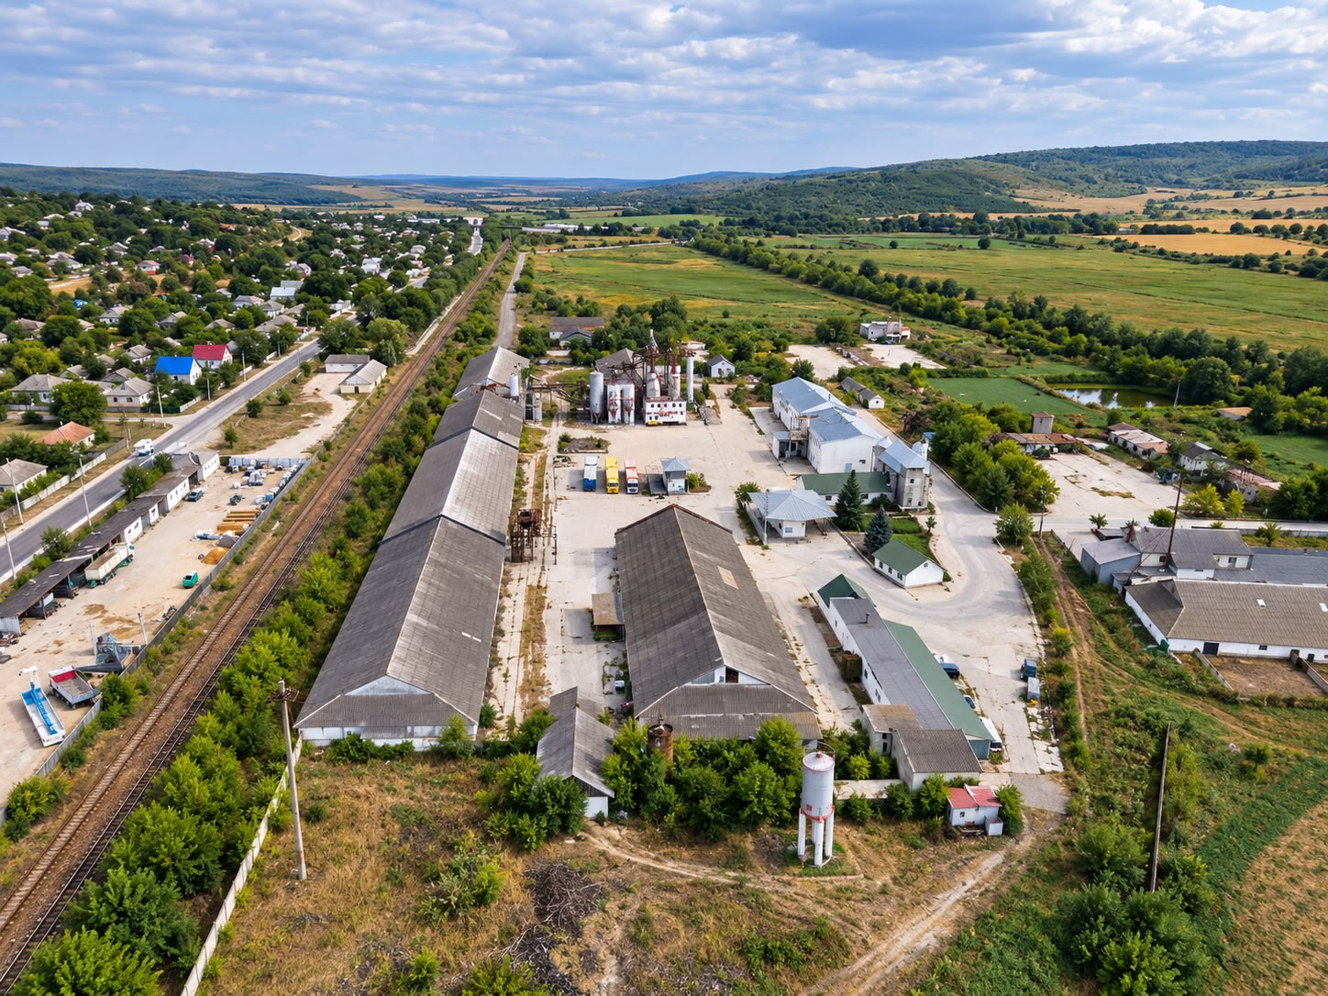
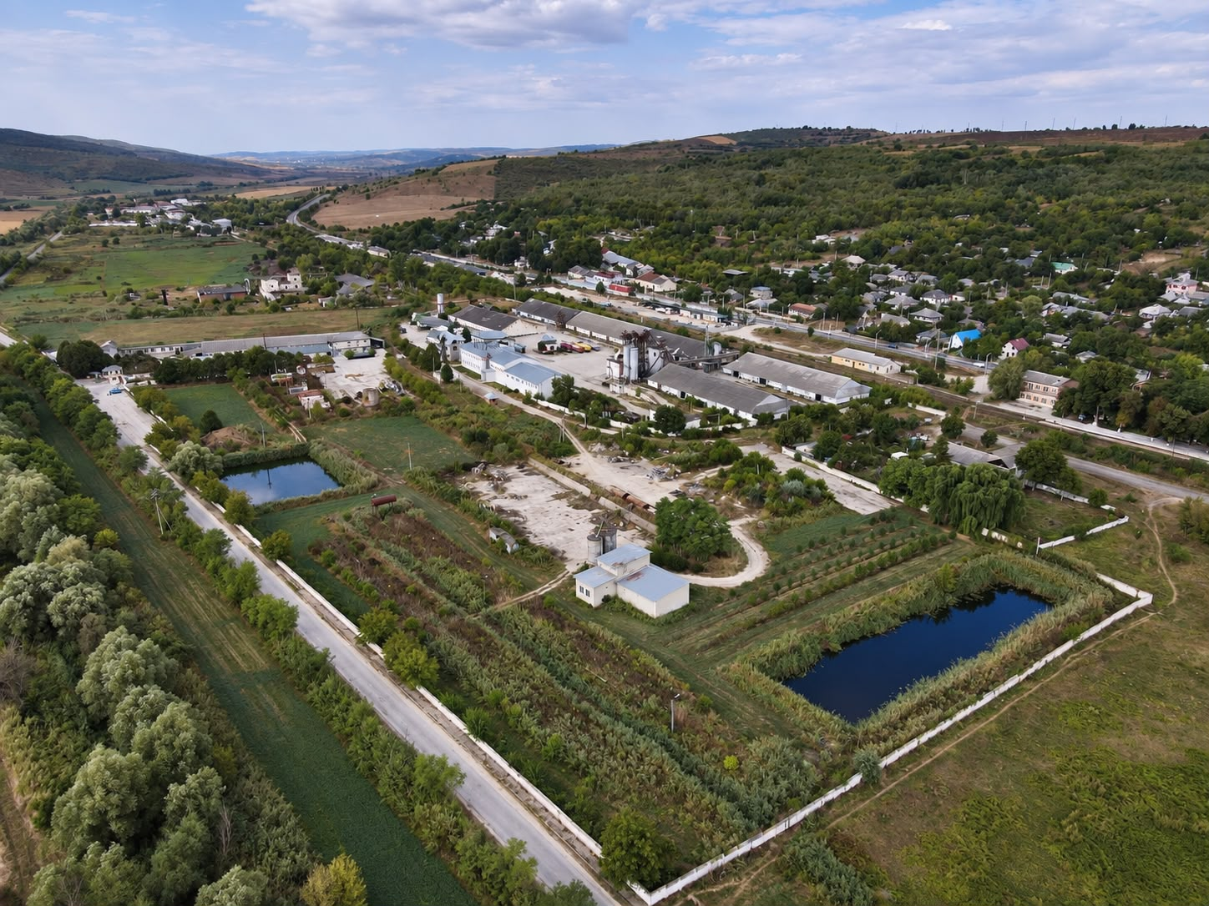
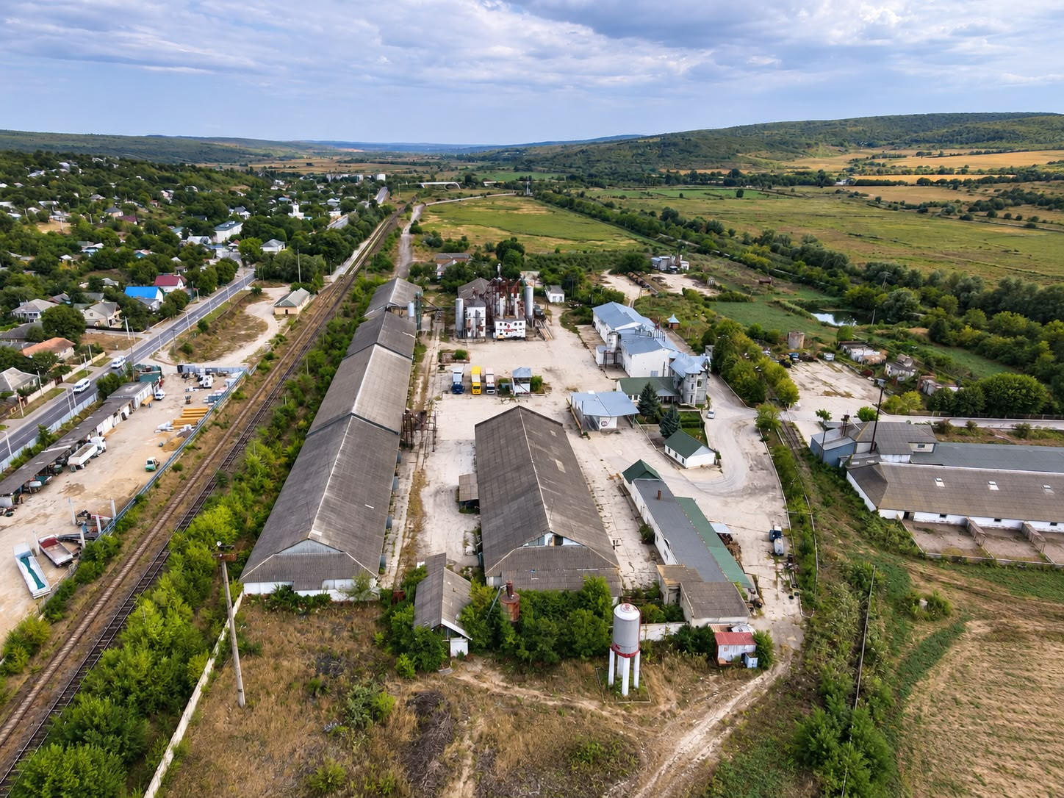
The Site in Pictures (2/2)
The site in relation to the town and the rail network
Overview — agricultural context and road access
Ponds, farmland and the industrial platform — panoramic view
Bucovăț Multimodal Industrial & Logistics Hub | Preliminary Investment Profile
3

Slide 4
Opportunity Summary
On a single existing 10.5 ha industrial platform, two complementary brownfield components, developed by Global Grain Solutions SRL on distinct zones of the same site — with no physical overlap or competition for resources.
WHY TOGETHER?
COMPONENT A
COMPONENT B
Rail-road terminal
Rapeseed processing
The components do not overlap physically — A uses the concrete platform and the railway; B uses the existing industrial building.
150,000 t/yr target capacity (gradual ramp-up)
~€195,000 CAPEX
~€279,000/yr result at capacity (~67% margin)
~1.5–2 years simple payback
29,700 t/yr capacity (90 t/day)
~€2.25 mil. CAPEX (range €1.7–2.5 mil.)
~€1.1–1.3 mil./yr EBITDA at capacity
€1.5–2.0 mil. working capital required
Combined, total CAPEX (~€2.45 mil.) comfortably exceeds the minimum eligibility threshold.
Diversifies the platform's revenue sources and makes full use of the whole asset (land, power, solar).
Bucovăț Multimodal Industrial & Logistics Hub | Preliminary Investment Profile
4

Slide 5
Strategic Rationale — Why Now
Existing infrastructure
1,500 m² building, former oilseed processing; ~980 m of internal railway; 9,000 m² concrete platform
CAPEX concentrated on technology, not construction
National corridors under development
R1 Chișinău–Ungheni–Romania, Unirii Bridge, A8 Motorway, Chișinău–Ungheni rail corridor
Long-term strategic positioning
Demand for construction materials
Growing sector, supported by public infrastructure projects
Customer base for component A
Oilseed agricultural base
Access to rapeseed from domestic and regional production
Feedstock for component B, to be confirmed contractually
Energy
~750 kW available power + 532 kW photovoltaic project, permits already obtained
Reduces the energy cost for both components
Bucovăț Multimodal Industrial & Logistics Hub | Preliminary Investment Profile
5

Slide 6
Operating Model by Component
COMPONENT A — TERMINAL
Ukraine
(feedstock)
Transport
rail
Bucovăț
unloading
Storage
9,000 m² platform
Transport
road
Customer
end user
COMPONENT B — RAPESEED PROCESSING
Reception
rapeseed
Cleaning /
drying
Pressing /
solvent extraction
Filtering
(crude oil)
Desolventizing
(meal)
Market
EU / RO
The two flows operate independently, in distinct zones of the platform, but share common utilities (power, road and rail access) — reducing the shared fixed costs of the hub.
Bucovăț Multimodal Industrial & Logistics Hub | Preliminary Investment Profile
6

Slide 7
Market and Demand
Channel
Possible role
Rule
Construction materials — domestic customers
construction companies, infrastructure contractors, concrete producers, asphalt plants
preliminary commercial agreements, minimum two anchor customers
Crude rapeseed oil — EU export
Romania, Bulgaria, EU, biodiesel/HVO industry
DAP Constanța reference price; netback to Bucovăț
Rapeseed meal
domestic market (feed industry) and regional — Romania, Italy
diversification across at least two commercial routes
Rapeseed feedstock
domestic and regional production
multi-year contracting; 20,000 t storage as a seasonal buffer
THRESHOLDS BEFORE FID
Component A: minimum two anchor customers with preliminary agreements for ≥60,000 t/yr. Component B: confirmation of at least 60–70% of annual rapeseed needs (~29,700 t) from domestic and/or regional sources.
Bucovăț Multimodal Industrial & Logistics Hub | Preliminary Investment Profile
7

Slide 8
Investment and Indicators
CAPEX
A — Terminal
~€195,000
B — Rapeseed processing
~€2,250,000
TOTAL
~€2,445,000
INDICATORS
Indicative simple ROI (combined)
~57–65%
Simple payback (indicative)
~2–3 years
IRR, NPV
N/A — to be calculated after FID
Bucovăț Multimodal Industrial & Logistics Hub | Preliminary Investment Profile
8

Slide 9
Risk Assessment
Feedstock base
HIGH
Rail infrastructure
MODERATE
Collaboration with multiple suppliers/customers; preliminary contracts
Technical expertise and detailed estimate before finalizing CAPEX
Feedstock price / crush margin
HIGH
Seasonality
MODERATE
DAP Constanța netback model; continuous margin monitoring
Use of existing storage capacity
FX (USD / EUR)
MODERATE
Technological yields
MODERATE
Invoicing in the target market currency; net exposure monitoring
Confirmation via the supplier's technological balance sheet
Bucovăț Multimodal Industrial & Logistics Hub | Preliminary Investment Profile
9

Slide 10
Investment Structure and Next Steps
Forms of investor involvement
01
02
03
Full acquisition of the asset — available at ~€4 mil.
LEGAL FRAMING
TECHNICAL DUE DILIGENCE
FIRM QUOTES (RFQ)
Acquisition of a stake
Asset status and conditions of use
Audit of existing infrastructure and utilities
Processing equipment and rail reconstruction
Joint venture
Dedicated project company (SPV)
04
05
06
Strategic partnership
COMMERCIAL VALIDATION
FINAL FINANCIAL MODEL
IMPLEMENTATION
Project / equipment financing
Anchor customers (A) and rapeseed volumes (B)
Confirmed CAPEX, NPV, IRR, ROI
Gradual modernization and operationalization
USAGE NOTE
Preliminary evaluation profile. It does not constitute a feasibility study, offer, prospectus, financial recommendation or commitment. The configuration, feedstock, financing structure and final indicators are to be consolidated through independent verification (due diligence).
Applicant contact
Global Grain Solutions SRL
Republic of Moldova, Chișinău, Tărînei St. 53/1
tel: +373 69244085
e-mail: info.globalgrainsolutions@gmail.com
Bucovăț Multimodal Industrial & Logistics Hub | Preliminary Investment Profile
10

