Slide 1
Moldova’s Regional State Aid Scheme for Investments 2024-2028
Prepared by Invest Moldova Agency

Slide 2

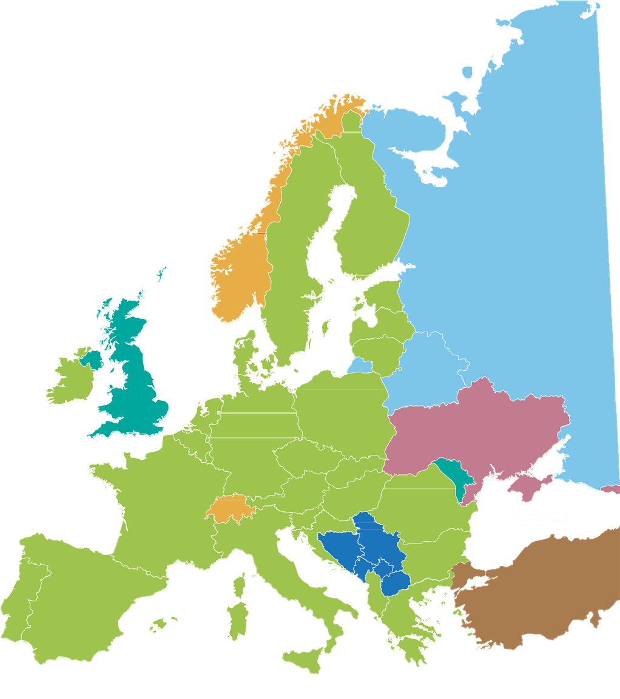

Overview of Moldova's Investment Incentives
The State Aid Scheme is designed to boost economic development through foreign investment. This comprehensive program provides significant financial incentives for initial investments in priority sectors, making Moldova an appealing destination for businesses looking to expand or establish operations in Eastern Europe.
25%
Grant
60% (75% for SMEs)
40%
Tax Exemption
75%
Total Budget:
EUR 100M
Focused on manufacturing & export-oriented industries
EUR 500K Minimum Investment
Maximum aid per project: 20% of total budget
Equiv. minimum investment of 10 million MDL

Slide 3

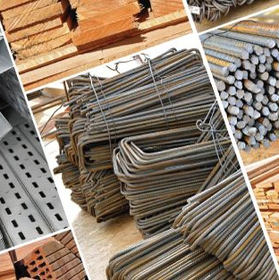







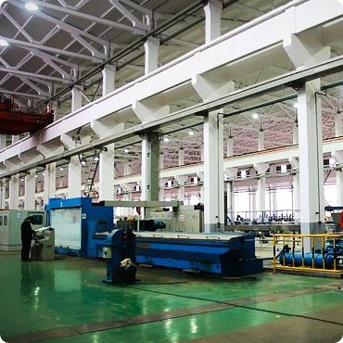








Eligible Sectors for Investments
The scheme is designed to support a wide range of investment types, from establishing new facilities to modernizing existing ones, with a clear emphasis on tangible and intangible assets that contribute to long-term economic development.
Eligible costs:
Tangible assets: land, buildings, equipment
Intangible assets: patents, licenses, know-how (up to 50% of total for large enterprises)
Types of eligible investments:
Setting up a new establishment
Expanding capacity of existing unit
Diversifying production
Fundamental change in production process
Chemicals & Pharma
Construction Materials
Electronics
Automotive Components
Textile & Clothing
Agrifood

Slide 4
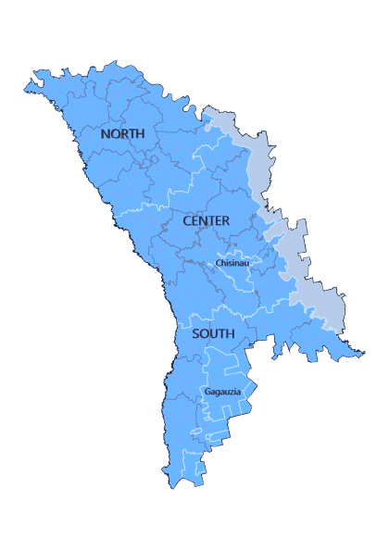

The maximum allowable Intensity of State Aid Investment
Scheme is based on region and company size:
Forms of State Aid
The maximum allowable Intensity of State Aid Investment
Scheme is based on region and company size:
Income tax exemption applies to tax obligations
due after investment completion.
North: Large (60%), Medium (60%), Small (75%)
Moldova's Regional State Aid Scheme offers a comprehensive support package for investors, combining direct financial assistance with tax incentives. This dual approach is designed to maximize the impact of the aid while providing flexibility for businesses of all sizes.
The scheme's long-term commitment, extending payments until 2036, demonstrates Moldova's dedication to fostering sustainable economic growth and supporting investors throughout their journey.
Two components of state aid:
Maximum aid intensity varies by enterprise size:
Large enterprises: 60%
Medium enterprises: 60%
Small enterprises: 75%
Center: Large (60%), Medium (60%), Small (75%)
Grant:
25% of eligible costs
Income Tax Exemption:
75% of eligible costs
Chisinau: Large (50%), Medium (50%), Small (50%)
South: Large (60%), Medium (60%), Small (75%)
UTA Gagauzia: Large (60%), Medium (60%), Small (60%)

Slide 5
Application Procedures
Eligibility Criteria
Application Submission
Initial Review
Comprehensive Evaluation
1
2
3
4
Review the scheme's requirements to ensure their project aligns with Moldova's priority sectors, primarily manufacturing and export-oriented industries. The planned investment must be in the minimum threshold of 10 million MDL (appro.500,000 EUR) and that the company is not in financial difficulty.
The Application package must include:
The main application form (Link:Model Cerere de acordare a ajutorului de stat regional pentru investiții);
Declaration form (Link:Model_Declarație);
Detailed business plan (Link: Model_Plan_Afacere).
Additional required documents include an extract from the State Register of Legal Entities, financial statements, and proof of the ability to provide at least 25% of eligible costs from own resources.
Applications can be submitted either physically or electronically through www.servicii.gov.md.
The Ministry conducts a preliminary evaluation within 10 working days. If the application is incomplete or lacks sufficient information, the Ministry will notify the applicant, who then has five working days to provide the requested additional information or documents. During this period, the evaluation timeline is suspended until a complete application is received.
An inter-institutional collegial body, created by ministerial order, conducts a thorough evaluation of the project and the applicant's eligibility. This body includes representatives from various ministries and agencies, ensuring a multi-faceted assessment of the investment's potential impact and alignment with Moldova's economic priorities. The evaluation considers factors such as the project's viability, its potential for job creation, and its contribution to regional development.

Slide 6
Application Timeline and Procedures
Signing of Agreement
Financial Commitment
Aid Disbursement
5
6
7
If the project is deemed eligible, the applicant is invited to sign the state aid agreement with the Ministry. This agreement outlines the specific terms of the aid, including the total eligible costs, the maximum aid intensity, the forms of aid (grant and income tax exemption), and the obligations of the beneficiary.
The agreement must be signed within 20 working days of receiving the notification of approval.
Before receiving any state aid, the beneficiary must demonstrate their ability to contribute at least 25% of the eligible costs from their own resources or external financing that is free from any public support.
This requirement ensures the investor's commitment to the project and shares the financial risk with the state.
Once all conditions are met, the beneficiary begins to receive the state aid. This comes in two forms: a grant covering 25% of eligible costs and an income tax exemption for the remaining 75%.
The aid is disbursed according to the schedule outlined in the agreement, with payments potentially extending until December 31, 2036.
Throughout this period, the beneficiary must maintain the investment for at least five years (three years for SMEs) and comply with all reporting and monitoring requirements set by the Ministry.

Slide 7







Key Benefits for Investors
Long-term commitment with aid payments extending until 2036
Generous financial support covering up to 60-75% of investment costs
Access to a skilled workforce and strategic location (EU & CIS markets)
Versatile support for various investment types (new facilities, expansions, diversification)
Efficient application process with transparent timelines

Slide 8
Reach out.
office@invest.gov.md

